Slide 1
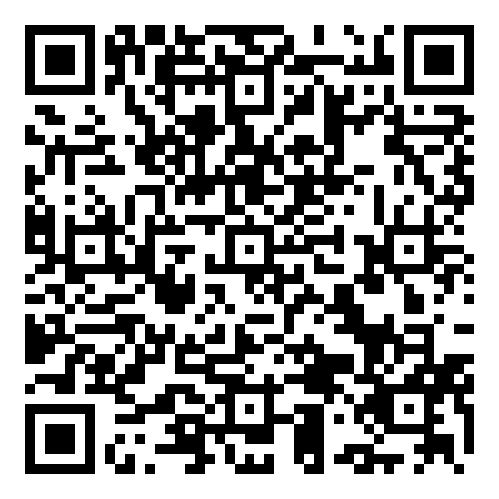
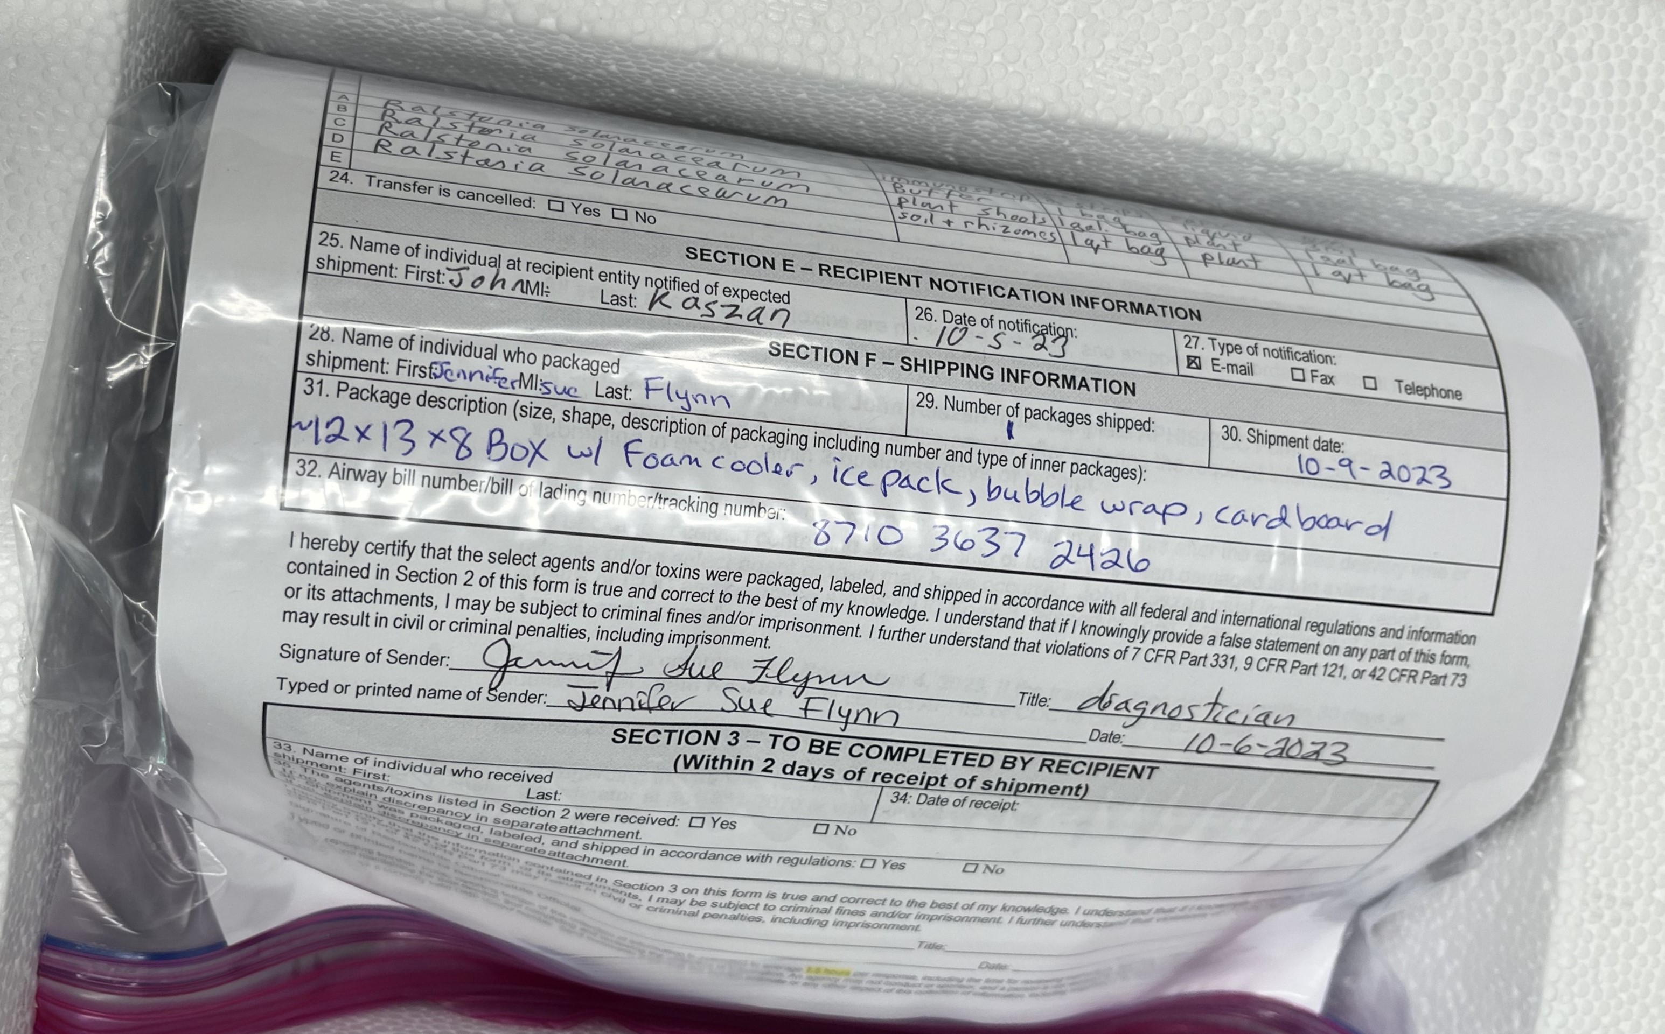
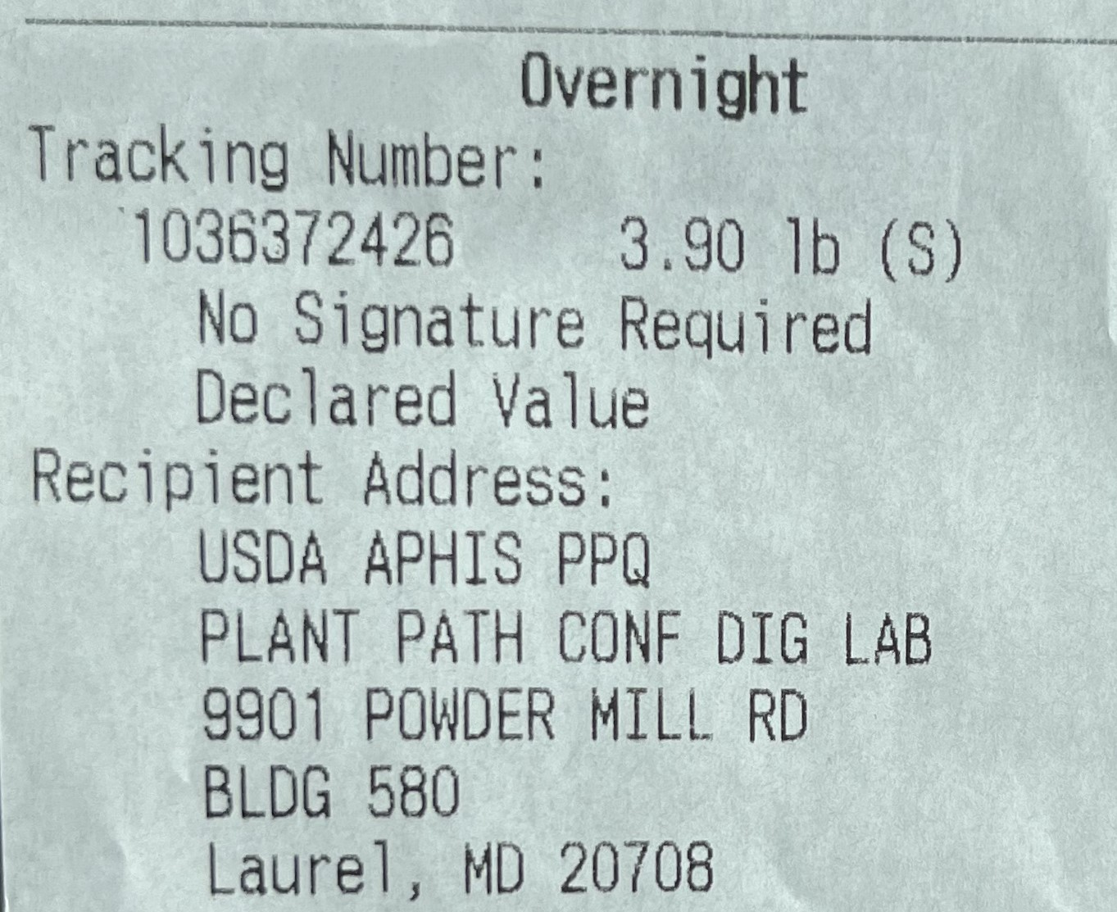
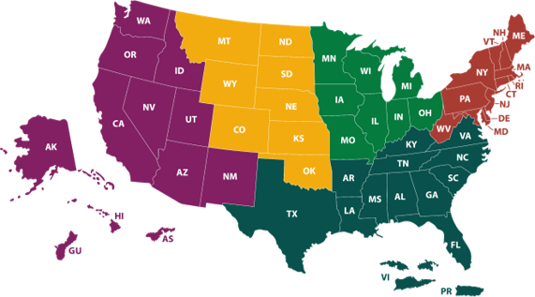
Diagnostic Confirmation and Communication Protocol
Kassie N. Conner (1); Samantha E. Fieweger (2); Gary D. Fish (3); Jennifer S. Flynn (4); Carrie L. Harmon (5); Sara E. Wallace (6)
Auburn University, Auburn, Alabama; (2) Wisconsin Department of Agriculture, Trade, and Consumer Protection, Madison, Wisconsin (3) Maine Department of Agriculture, Conservation and Forestry, Augusta, Maine; (4) University of Minnesota, St. Paul, Minnesota; (5) ​ University of Florida, Gainesville, FL (6) Oklahoma State University, Stillwater, Oklahoma
The Diagnostic Confirmation and Communication Protocol was created by the NPDN Regulatory Relations committee to help NPDN members, diagnosticians, and plant disease laboratories navigate the complex landscape of plant disease regulation and official confirmation. This protocol is maintained by the NPDN regulatory relations committee whose membership is made up of individuals from Land Grant Universities, National Plant Board, Local Regulatory Authorities, USFS, and USDA.
Use the QR code on this poster to find links to the webpages, emails, and forms mentioned below and a list of the acronyms used.
If you suspect a new, regulated, or otherwise significant pest
Contact the sample state’s: State Plant Regulatory Official (SPRO) and State Plant Health Director (SPHD). The SPHD will enter the information into the ARM system and provide a diagnostic receipt form to the lab submitting the sample. Samples cannot be shipped and will not be accepted by PPCDL without the diagnostic receipt from ARM.
Courtesy contact the local National Plant Diagnostic Network (NPDN) diagnostician or State Department of Agriculture (SDA) diagnostician, in the sample’s state and those who may receive similar samples.
Contact the USDA APHIS PPQ Domestic Diagnostic Coordinator for instructions on how and where to mail a sample for confirmation.
Use USDA-PPQ FORM 391 with sample submissions
Ship samples via overnight express courier (e.g. DHL, FedEx, UPS). Ship samples early in the week and never before a holiday. Do not require a signature and include the ARM diagnostic receipt and USDA PPQ 391 from in the package.
If you suspect a Select Agent
In addition to the items to the left you will also need to:
Closely follow the language in your 526 permit.
Your Plant Disease Diagnostic lab’s 526 permit contains this or similar language: “If any organism listed as a Select Agent is identified from materials associated with this research, the 526 permit holder is required to notify APHIS, Agriculture Select Agent Services (AgSAS) immediately by phone at 301-851-3300 option 3, and within seven (7) days of identification submit APHIS/CDC Form 4A (Report of Identification of a Select Agent or Toxin in a Clinical or Diagnostic Laboratory) to APHIS, AgSAS; 4700 River Rd, Unit 2, Riverdale, MD 20737.”
Failure to comply with this requirement is a violation of the Agricultural Bioterrorism Protection Act of 2002.
Contact your organization's Safety Officer to determine their role and requirements in the specific detection.
Current USDA-PPQ Select Agents
Coniothyrium glycines (formerly Phoma glycinicola and Pyrenochaeta glycines)
Peronosclerospora philippinensis (P. sacchari)
Ralstonia solanacearum
Rathayibacter toxicus
Sclerophthora rayssiae
Synchytrium endobioticum
Xanthomonas oryzae
If you suspect a new, regulated, or otherwise significant pest
If you suspect a Select Agent
Figure 1: A sample properly packaged for transport with the correct accompanying forms.
Figure 2: A shipping receipt with a tracking number and “No Signature Required”.
USDA Plant Pest and Disease Programs
Results
Plant Diseases | Insects and Mites | Other
Black Stem Rust/Barberry | Asian Longhorned Beetle | Giant African Snail
Chrysanthemum White Rust | Box Tree Moth | Golden Nematode
Citrus Diseases | Coconut Rhinoceros Beetle | Pale Cyst Nematode
Cucumber Green Mottle Mosaic Virus | Cotton Pests | Witchweed
European Larch Canker | Emerald Ash Borer
Gladiolus Rust | European Grapevine Moth
Karnal Bunt | Flighted Spongy Moth Complex
Phytophthora ramorum | Fruit Flies
Plum Pox | Glassy-Winged Sharpshooter
Potato Diseases | Grasshopper/ Mormon Cricket
Ralstonia solanacearum | Honeybee Pests
Sugarcane Diseases | Imported Fire Ant
Thousand Cankers Disease | Japanese Beetle
Ralstonia | Old World Bollworm
 | South American Cactus Moth
 | Spongy Moth
 | Spotted Lanternfly
Results
Official USDA results will only be reported back to the SPHD and SPRO. They are responsible for forwarding official USDA results to sample submitters, diagnosticians and other relevant entities. Following up is recommended to determine outcome.
NPDN Regional Center Labs – Here to Help!
NPDN Regional Center Labs – Here to Help!
If you need assistance in identifying a potentially new or high impact pathogen NPDN regional centers may be able to help. Contact your regional center, local regulatory authority and/or NPDN contact for more information about their testing capacity.

