Slide 1
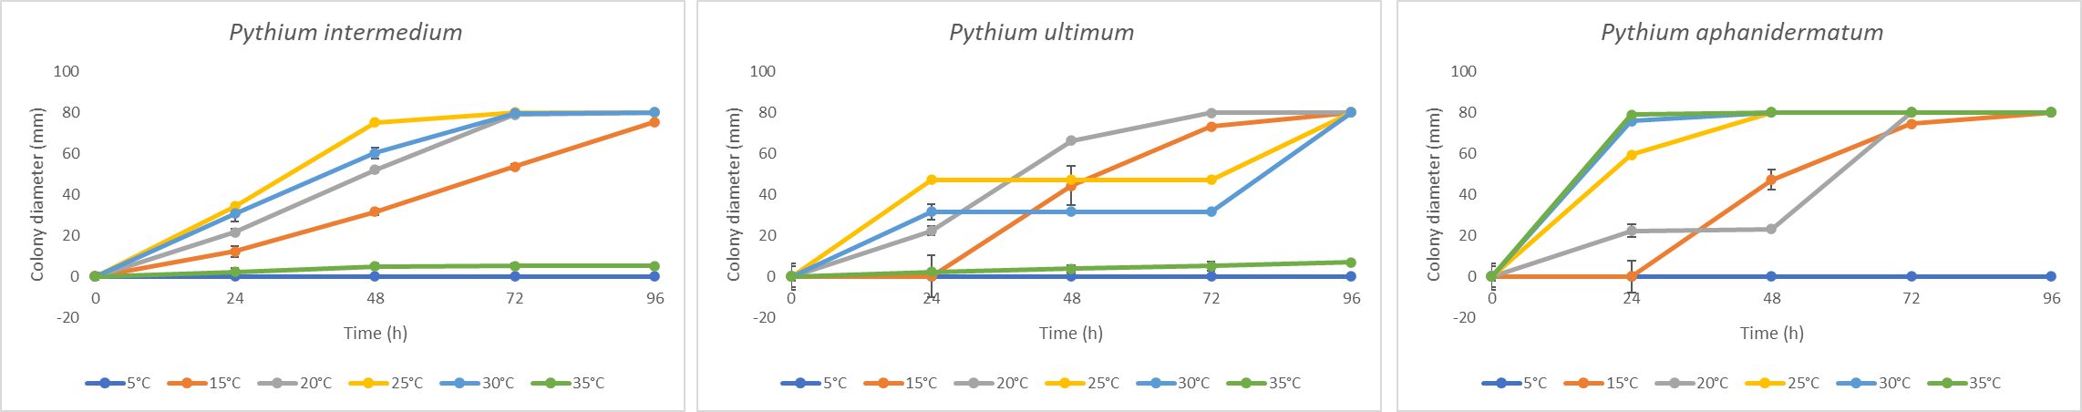
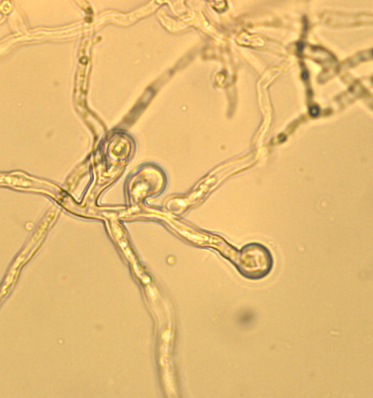
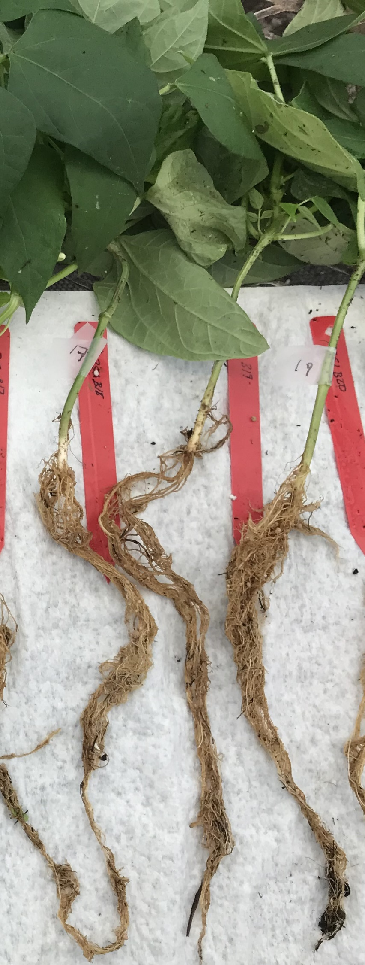
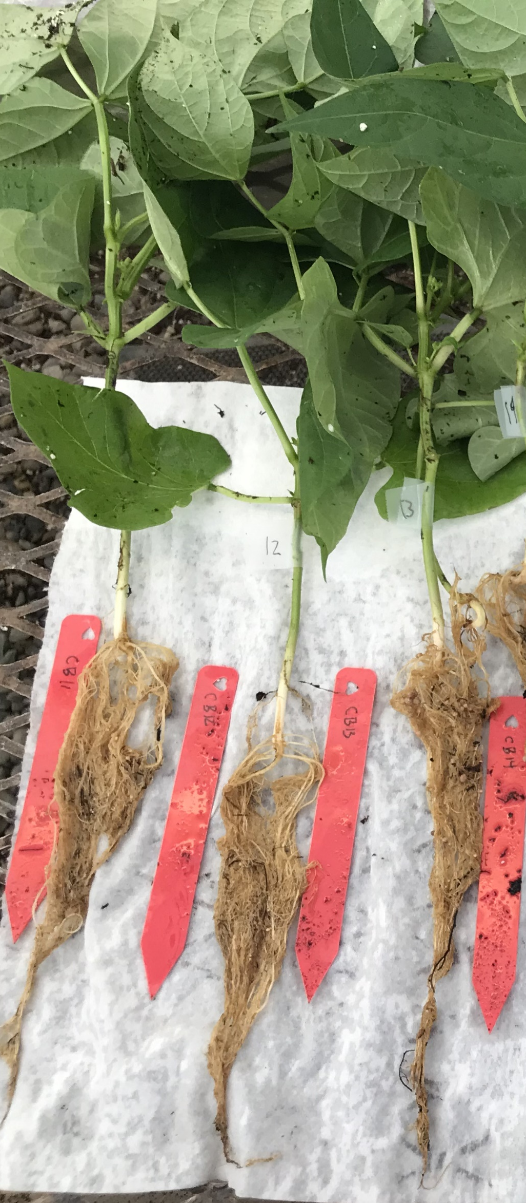
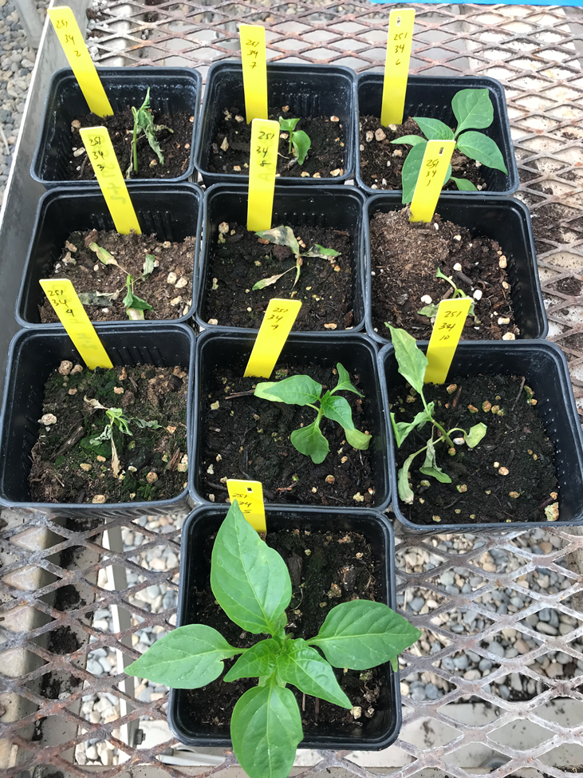
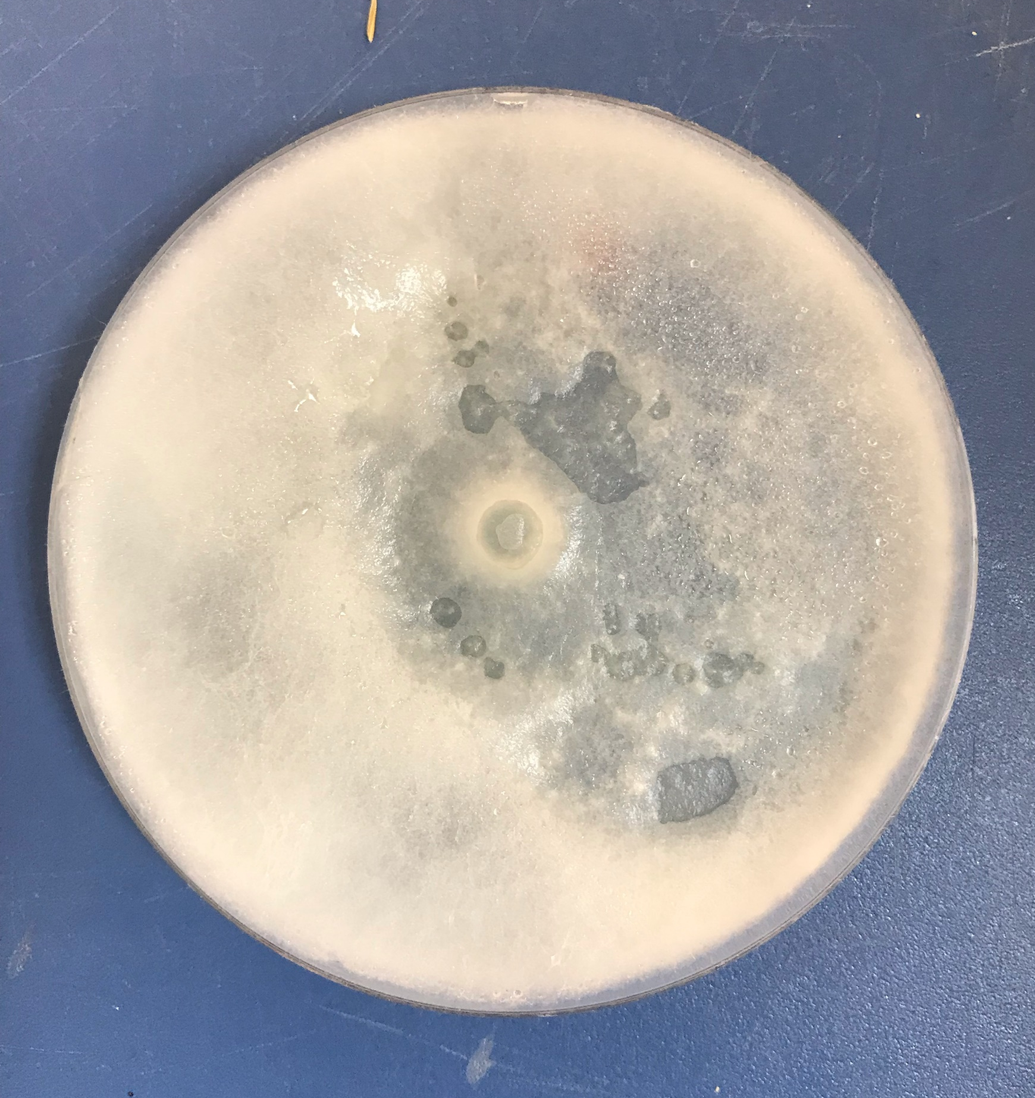
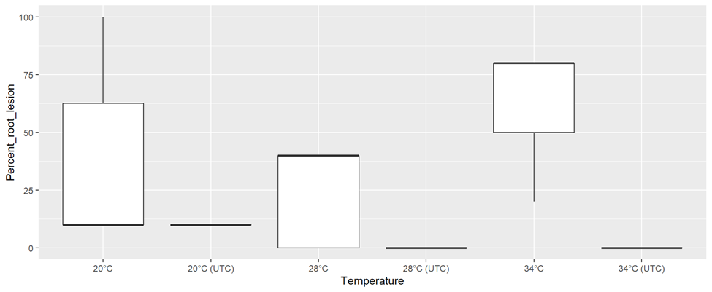
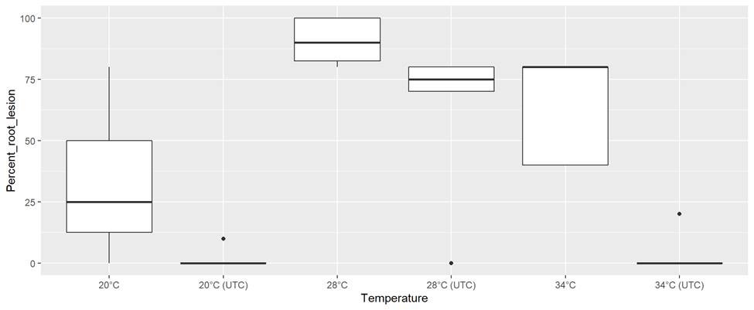
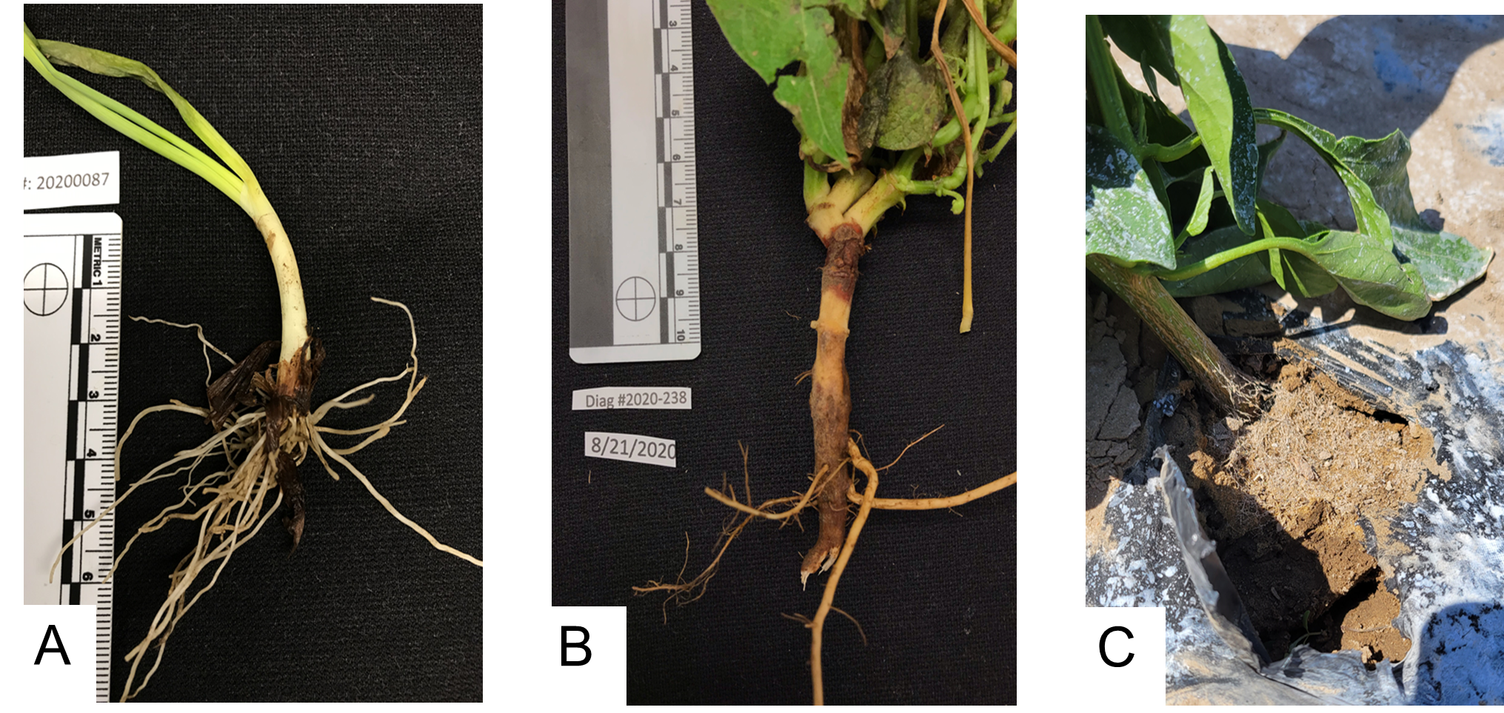
Occurrence of Pythium aphanidermatum due to the Pacific Northwest 2021 heat wave
Introduction and Objectives
A
B
C
A
C
D
100μm
In late June to mid-July 2021, record high temperatures were observed in the Pacific Northwest. Diseased bean samples from southwest and southcentral Idaho and bell pepper samples from eastern Oregon were diagnosed at Parma Research and Extension Center. Pythium was consistently recovered from diseased material and sequence confirmed Pythium aphanidermatum. This appeared to be a new host record for both states on these crops. A review of literature indicated that P. aphanidermatum had a higher growth temperature than other Pythium species we encountered in the lab such as Pythium ultimum. We then hypothesized that the heat wave may have facilitated these outbreaks. The goals of this research were to evaluate the temperature on the growth of Pythium species in vitro and their pathogenicity in bell pepper and pinto bean.
Fig. 2. Mean colony diameter of (A) Pythium intermedium, (B) Pythium ultimum, and (C) Pythium aphanidermatum on PDA at five temperatures.
B
A
B
C
inoculated
control
E
Fig. 4. P. aphanidermatum (A) toruloid zoosporangia, (B) culture on PDA, (C) inoculated, (D) non-inoculated pinto bean, and (E) inoculated bell pepper with damping-off symptoms at 34°C.
Fig. 3. Root lesions on (A) bell pepper and (B) pinto bean caused by P. aphanidermatum across temperatures.
Methodology
Conclusions
1
Agar plugs of three Pythium species grown on PDA at 5°C, 15°C, 20°C, 25°C, 30°C, and 35°C
1
Temperature and host type have differential effects
on disease severity caused by Pythium species.
This finding could be incorporated into disease management for Pythium species affecting bell pepper and pinto bean.
2
Measurement of colony diameter for 4 days
and oomycete species identification by sequencing
2
References
3
Inoculation of 2-3-week-old bell pepper (cv. Huntington) and pinto bean (cv. Wind breaker) with agar plugs at the seedling base.
Matthiesen, R.L., Ahmad, A.A., and Robertson, A. E. 2016. Temperature affects aggressiveness and fungicide sensitivity of four Pythium spp. that cause soybean and corn damping-off in Iowa. Plant Disease 100: 583-591.
Thomson, T. B., Athow, K. L., and Laviollete, F. A. 1971. The effect of temperature on the pathogenicity of Pythium aphanidermatum, P. debaryanum, and P. ultimum on soybean. Phytopathology 61:933-935
Fig. 1. Pythium intermedium isolated (A) from onion (southern Idaho), Pythium ultimum (B) from pea (south-central Idaho), and Pythium aphanidermatum (C) from bell pepper (southwest Idaho).
4
Incubation of pots in 20°C, 28°C, and 34°C heat mats. Root disease rating 4 weeks post-inoculation and data analysis
AUTHORS
Christian J. Cumagun, Benjamin Wood, Mackade Murdock,
and James W. Woodhall
Parma Research and Extension Center, University of Idaho, Parma, Idaho 83660, USA Email: ccumagun@uidaho.edu
.

